Slide 1

“The Most Valuable Commodity that I know of is Information”.
-Gordon Gekko’s character from Wall Street

Slide 2
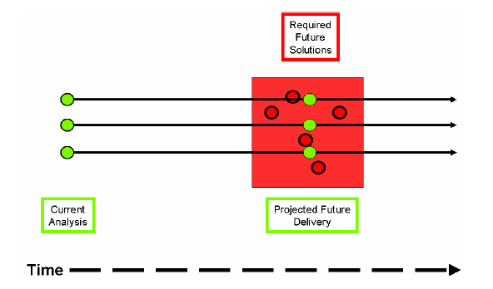
Where is our Information?
Data is only as useful as the decisions it enables
Courtesy of NEHTA
Notes:
Typical setting of our data- eg Child Health x 3 Systems, not to mentin audiology, dentistry and horizontal.as well as longuitudinal data
Same for Cardiology

Slide 3
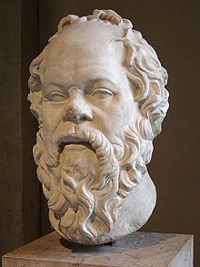
Socrates (c.469-399 BC)
“The beginning of wisdom is the definition of terms.”

Slide 4
What we use data for
Describing
What happened?
How many?
How much?
How often?
Where?
Predicting
Why is this happening?
What if these trends continue?
What will happen next (predict)?
What is the best that can happen (optimise)?
V.
Discovering
Is this a pattern?
Causal?
Co-relational?
Data Quality?

Slide 5
What is your current “Advanced Data Analyst” Organisation Model ?
?
Describing
Predicting
Discovering
?
?
Standards Based
Non Standardised

Slide 6
The Integrated Services Framework (ISF) Contribution
An Interoperability Framework offering a shared Standards Based Tool and language for defining and aligning the business and interoperability context for our eHealth systems.
  An integrated services architecture which is independent of technology.
  Embraces all of our core ICT systems & technologies
  Enable the HSE to overcome data silos and facilitate systems and services to grow in a standardised, aligned and evolutionary manner.
  The Framework is comprised of 12 workstreams, is based upon proven international best practices and standards
  The ISF Framework is a collaborative project

Slide 7
Tender Deliverables
Determination of the (Standards Based) Information Model
Specification for the (Standards Based) Data Dictionary
Terminology Assurance
Support Processes & Services

Slide 8
Tender Deliverables
Determination of the Information Model
Specification for the Data Dictionary
Terminology Assurance
Support Processes & Services

Slide 9
Part-1 Determination of the Information
Architecture Reference Model
The establishment of a suitable standards based Information Architecture Reference Model (IA-RM)
The provision of a standards based subject area model (SAM)
The determination of which technical systems should participate in the subject area model (SAM)
Recommendation of a Governance Framework and Tooling for Model maintenance and expansion
A catalogue with the Standards and associated sub-sections for the Model

Slide 10
Part-2 Data Dictionary
The determination of a Standards Based Data Dictionary including the specification of meta data structure, data classes, entities and attributes
Validation (Proof-of-Concept) of the Data Dictionary
Recommendation of a Governance Framework and Tooling for Dictionary maintenance and expansion
A catalogue with the Standards and associated sub-sections for the Dictionary

Slide 11
Part-3 Terminology Assurance
The determination and validation (Proof-of-Concept) of a terminology (SNOMED CT) for the IA-RM Model
Provision of a blueprint for the deployment, management and maintenance of the terminology service
Validation of the proposed model thought the binding of SNOMED CT concepts to a specified clinical data set
A catalogue with the Standards and linkages associated with its operation and maintenance

Slide 12
Part-4 Support Processes & Services
What standards based toolsets are required to manage the collective practical outputs and relationships of the information components listed above
A brief comparison of the commercial and open source products that best meet this need
The recommendation of an established toolset and management approach to facilitate integrated
governance of the data model, data dictionary and terminology service.

Slide 13
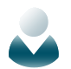











A Simple Use Case
Guidance
Documents
Research
GP
Business User
Procurement
Standards
Data Structure
Data Types
Business Case
Technical &
Information Architecture
Vendor Selection
Delivery
Maintenance
Delivery Platform
Stakeholders
Data Dictionary
Terminology Binding
Data Registry/
Repository
ICT Delivery
Distributed Applications
(Tertiary Care)
Procurement
Deployment

Slide 14



Accessing the Information
Cohort Segmentation
CMO, CQO, ICP, Patient Safety, Operations
Access Portal
Analytic Tools
Data Aggregated, Translated from Disparate Sources
Common Vocabulary and Code Sets
Research
Financial/Administrative
Clinical Data
$$
Notes:
If you build from the bottom up – you get another view of the IT environment.

Slide 15
The Data Centre
All users / apps see only standardised and cleaned data: i.e. “TRUTH”
Users
Standardised
Data Feeds
Reports
Admin.
Extract
Transform
Load
Business Intelligence
Dashboards
Inventory
Data Warehouse
Operational
Systems
Data Mart
Planning
Standardisation,
Cleaning,
Auditing,
…
ad hoc
Queries
Etc.
Data Mart

Slide 16
Approach
Workshops
Interviews
Questionnaires
Feedback Sessions
Demonstrations

Slide 17
Timeline
Requirement | Due Date
Determination of the Information Model | Fri 31/01/14
Data Dictionary | Fri 31/01/14
Terminology Assurance | Fri 28/03/14
Support Processes & Services | Fri 28/03/14

Slide 18
End of Part 1

